Slide 1
Mid-Semester Presentation:
Green Infrastructure Database
Shreeya Pinumalla, Daniel Martins, Hunter Horst, and Feras Ismail

Slide 2
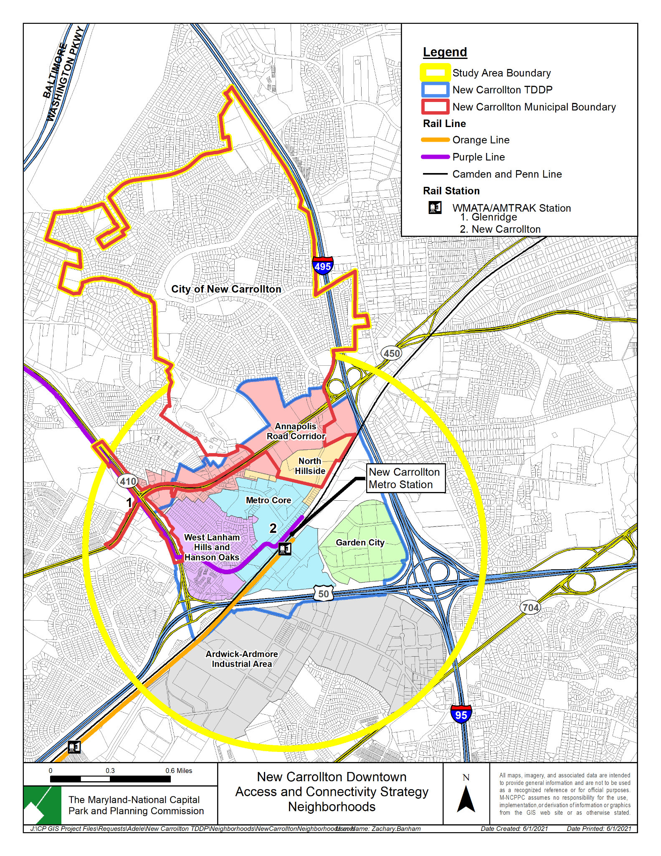
Basic Overview
We’re working with the City of New Carrollton to develop a green space database – the first of its kind for the city
Our goal is to make green spaces more accessible for the city’s residents and create a tool that could shape the city’s future

Slide 3
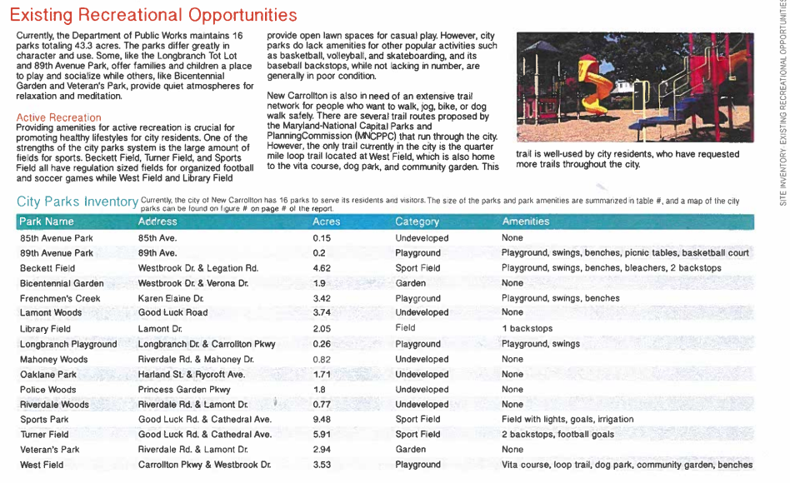
Background Research
New Carrollton Green Team
Part of a statewide program to promote sustainability
2018 - Today
New Carrollton City Park Revitalization Master Plan
A 2016 plan to renovate the city’s various green spaces
Gives detailed info about each space
Acreage, location, amenities, slope analysis, stormwater drainage
As well as suggestions for improvement and utilization

Slide 4
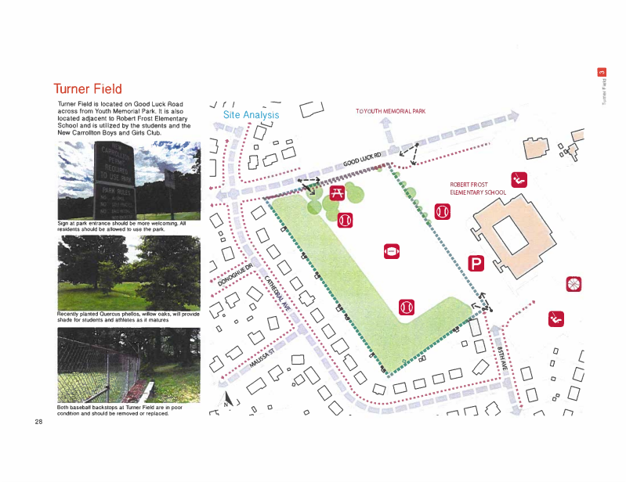
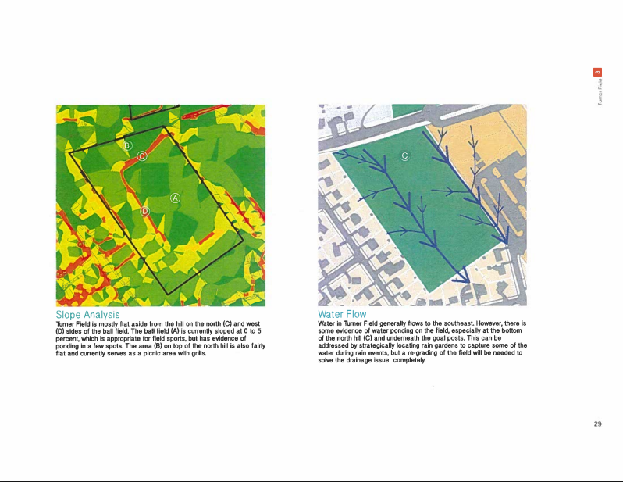
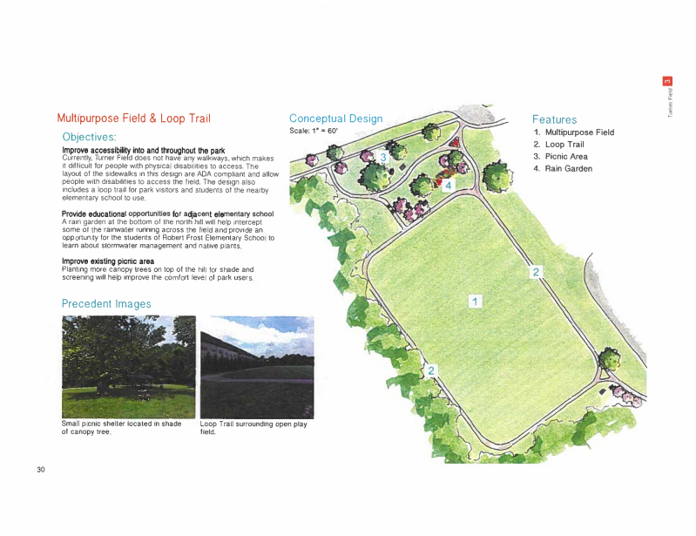

Slide 5
Current Status
We are currently waiting back to hear from the mayor so that we can reschedule a call with her.
From our first meeting with the director of IT, we’ve learned:
New Carrollton has no kind of parks and planning department
They are short staffed so communicate through IT Director Andrew Facey
He did not have any information about their green space data
We are looking at examples of how we will present the project; ex: a website, a pdf of our data and visualizations, etc.
As stated before, we do have the 2016 green infrastructure plan to work off of.
Notes:
Daniel Martins

Slide 6
Plans & Expectations
We expect to get in contact with the mayor within the next two weeks.
We plan on creating a SQL database with all the green space data we have.
Using the database, we will create visualizations to make the data easier to read.
To present the visualizations, we will create a website displaying all of our findings.

Slide 7
Thank You!

